Slide 1
Rides Project
Eugene Cheah
Mengting Yang
Rahil Shah

Slide 2
Abstract
An application to optimize Uber and Lyft drivers’ rides in Boston.
For Driver:
Improvizing rides to decide upon his/her own schedule
Maximize earnings in a shorter time
Know all the best driving locations where ride-hailing customers are densest
For Customers:
Have an idea about when rides’ prices are the cheapest
Compare the price between Uber and Lyft

Slide 3
Introduction
Data Source: Uber API, Lyft API, Yelp API, Weather API
Factors: Time, Day, Location, Weather, Temperature, Special Events
Learning methods:
Time Series, Support Vector Machines, K- Nearest Neighbors, and Naïve Bayes

Slide 4
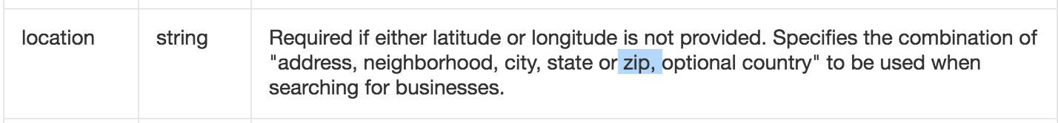
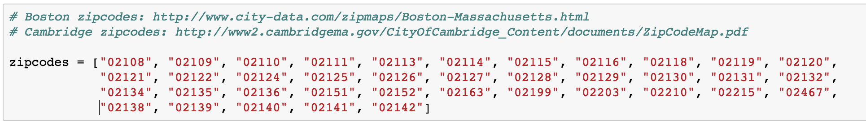
Code with Documentation
1.Select Locations: Boston and Cambridge areas
2.Get Zipcode in Boston and Cambridge areas

Slide 5
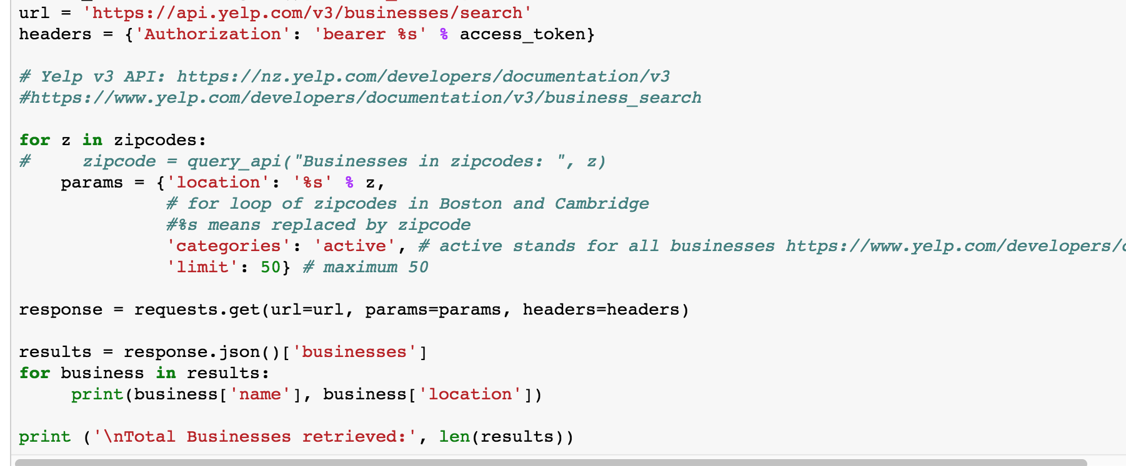
3. Get Locations and Coordinates according to Zipcode
and Create Yelp database to store data

Slide 6
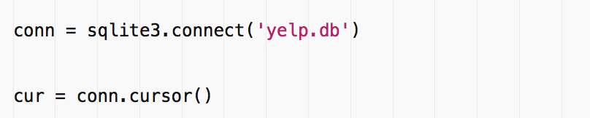
4. Connect to Yelp Database in Script
* SQLite is a relational database management system and it is not a client–server database engine. Rather, it is embedded into the end program.
* It allows accessing the database using a nonstandard variant of the SQL query language

Slide 7
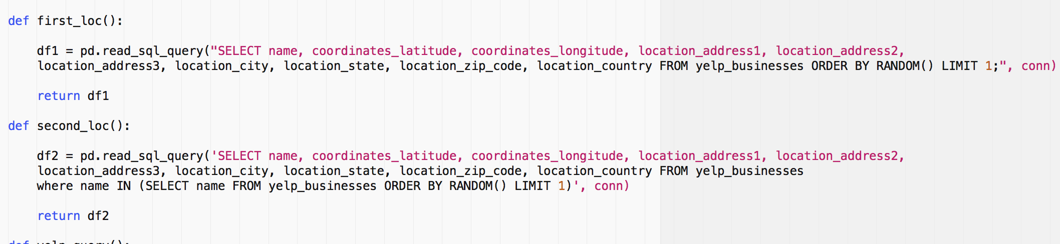
5. Get the Start Location and End Location of each query
* The distance between start and end location should larger than one mile

Slide 8
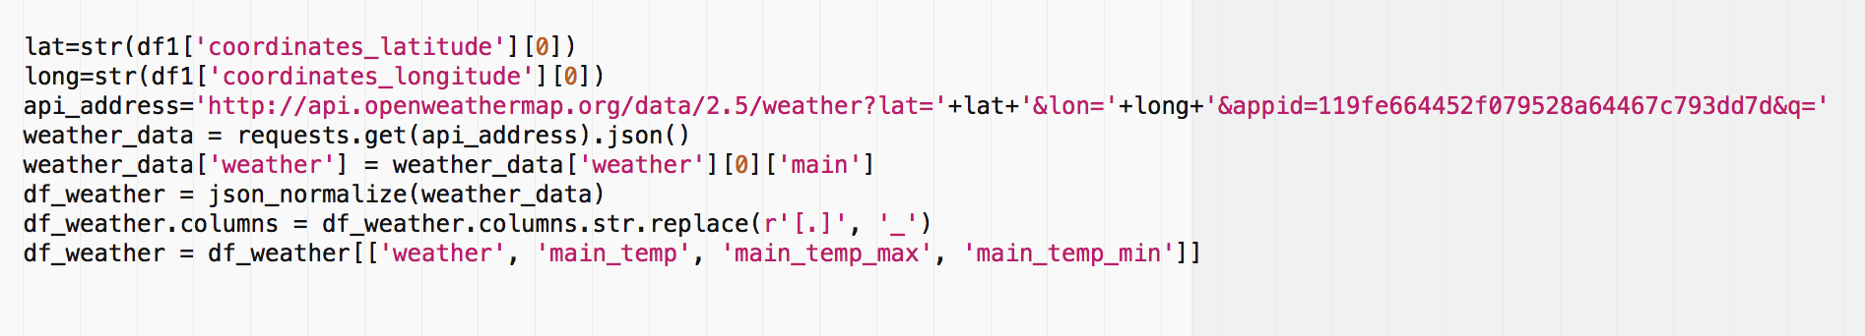
6. Get the Weather and Temperature

Slide 9
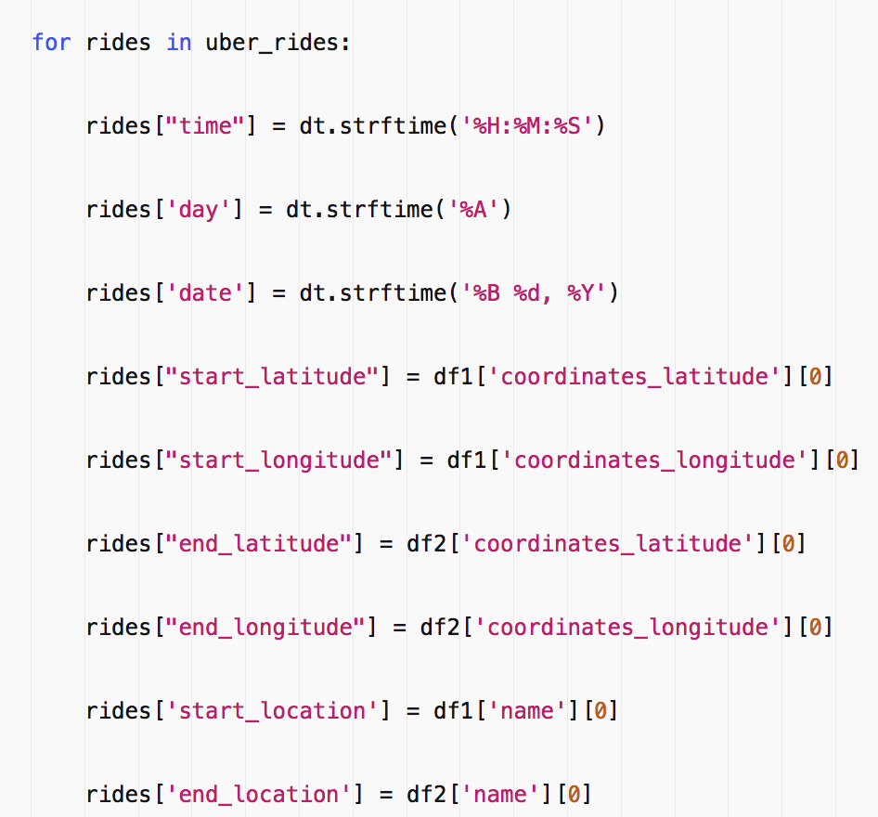
7. Get data of Uber rides

Slide 10
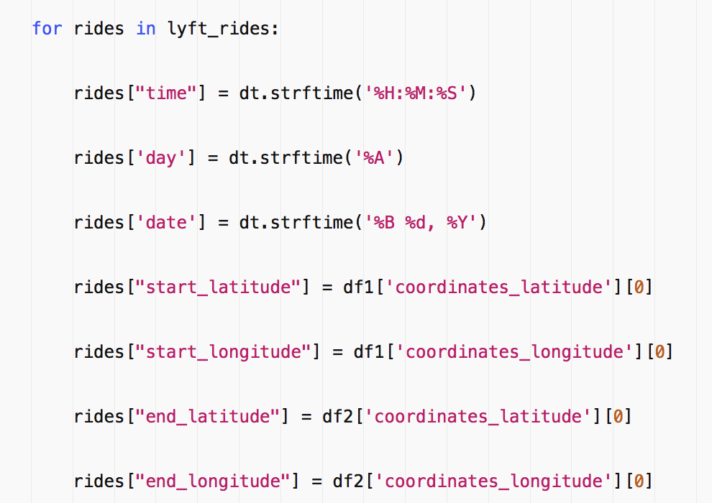
8. Get data of Lyft rides

Slide 11
9. Put it on server to run for one week
We choose Amazon Web Services (AWS) and set up an Ubuntu server to perform a Cron Job. It executes our Python script every three minute via crontab, which continuously appends data to and increases the file size of the csv file.
* Ubuntu is an open source software operating system that runs from the desktop, to the cloud, to all your internet connected things

Slide 12
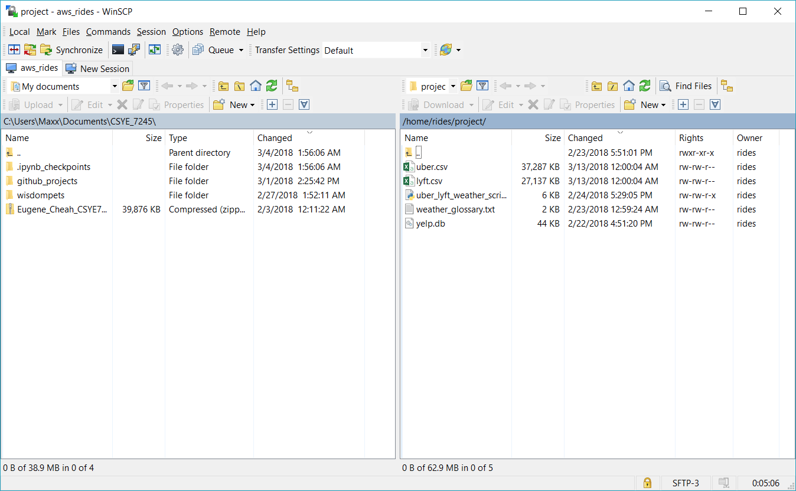
screenshot of the server

Slide 13
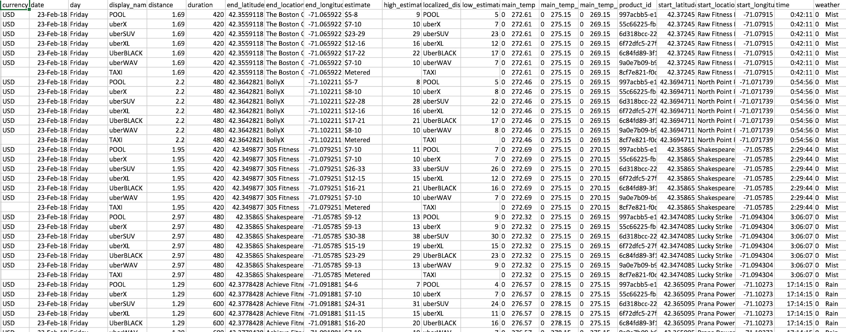
Uber.csv

Slide 14
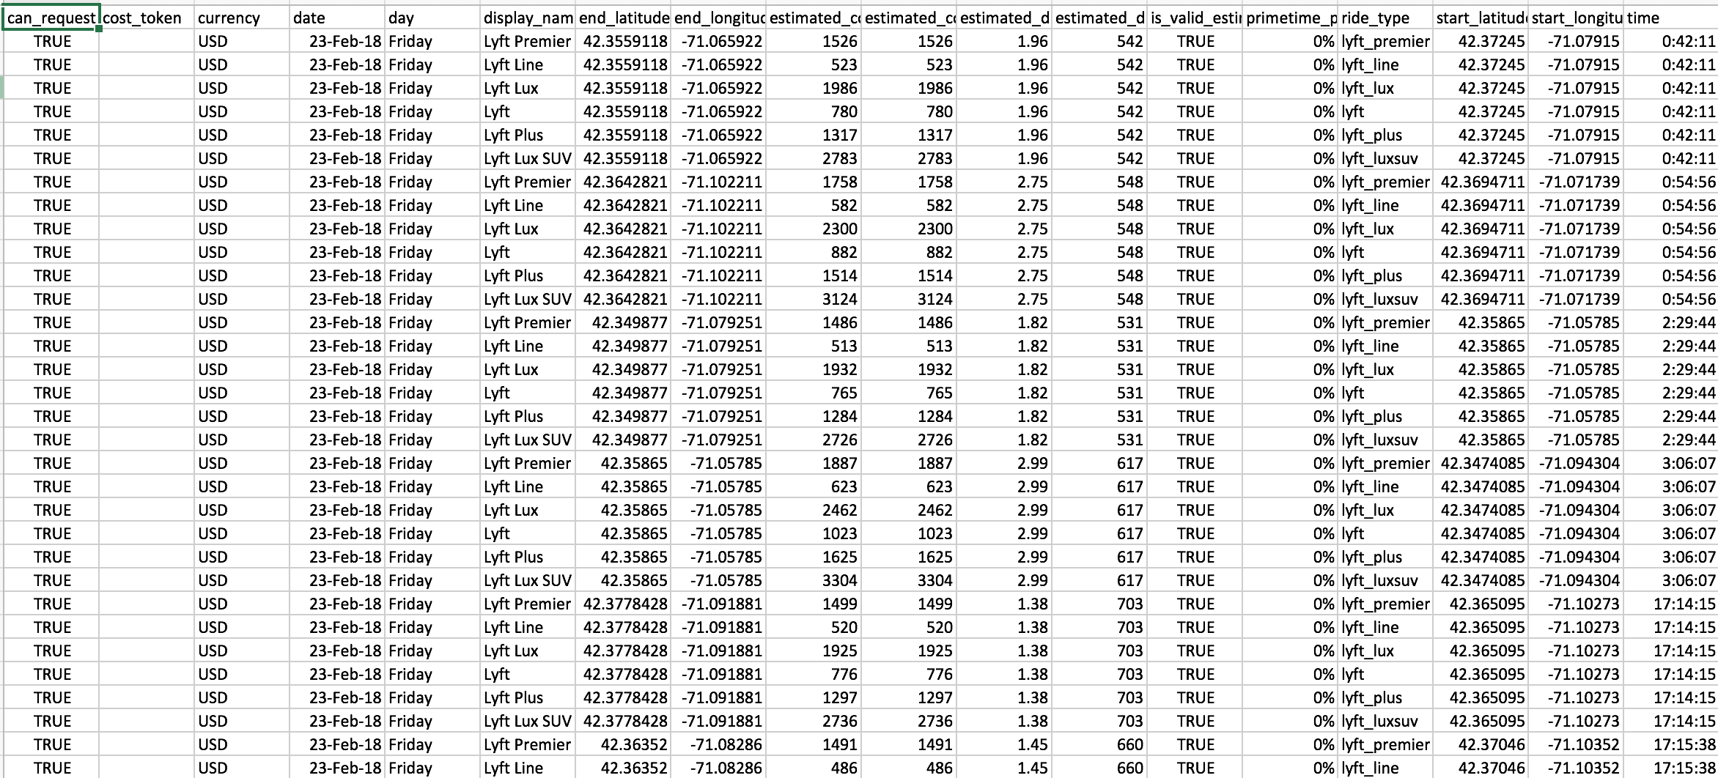
Lyft.csv

Slide 15
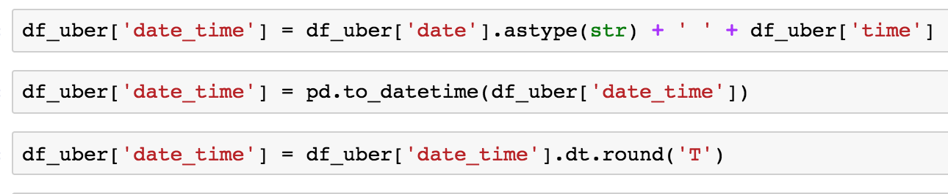
9. Read Uber csv
Combine day and time and round into minute

Slide 16
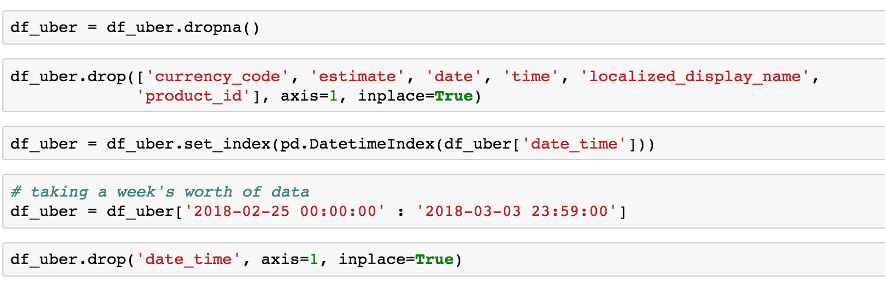
10. Drop null and unnecessary columns
set time as index
select the time period

Slide 17
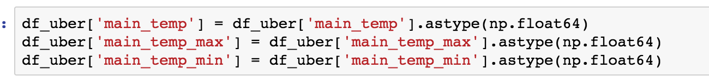
11. Transform inappropriate data types

Slide 18
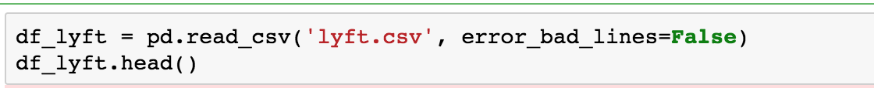
11. Read lyft csv (most same as Uber)
* error_bad_lines: Lines with too many fields (e.g. a csv line with too many commas) will by default cause an exception to be raised, and no DataFrame will be returned. If False, then these “bad lines” will dropped from the DataFrame that is returned.

Slide 19
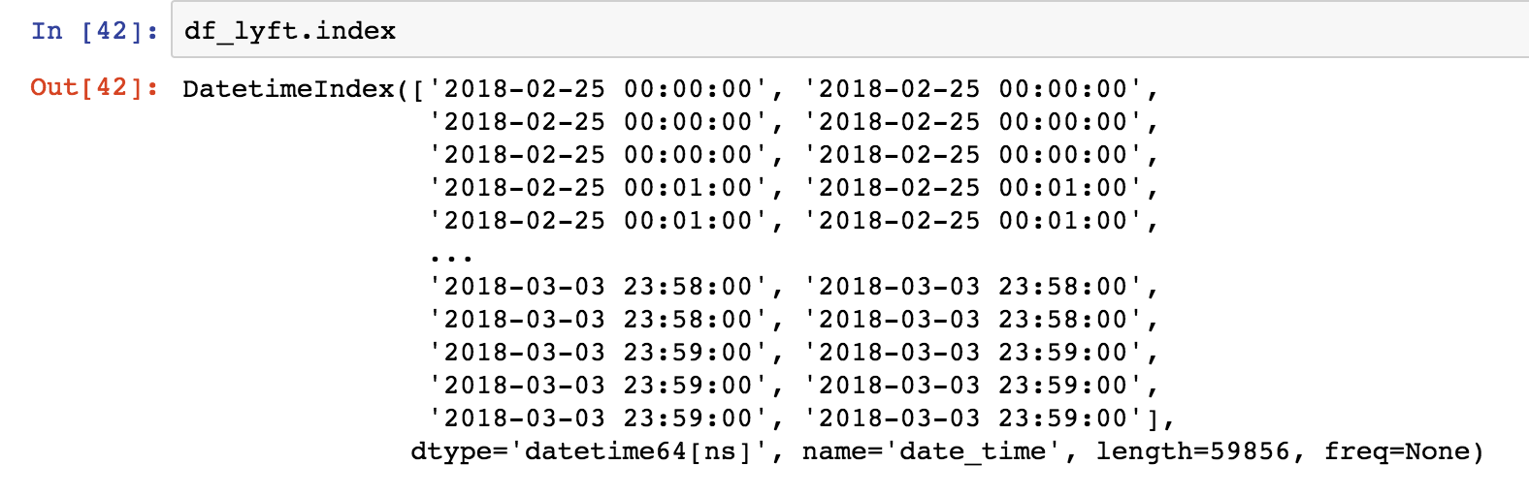
12. Check Index

Slide 20
13. Drop unecessary columns
* date, day, time are same as Uber

Slide 21
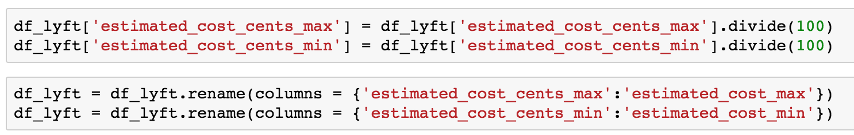
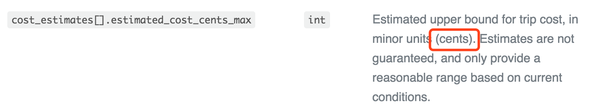
14. Make sure the cost expressed in same way between Uber and Lyft
* Lyft uses cents while Uber uses dollars

Slide 22
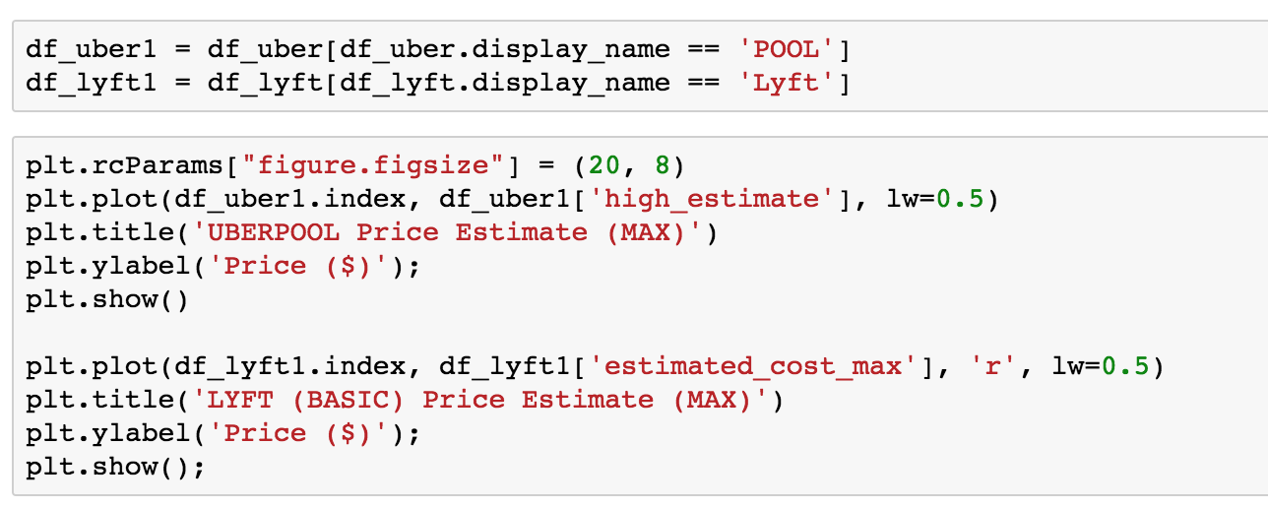
Result

Slide 23
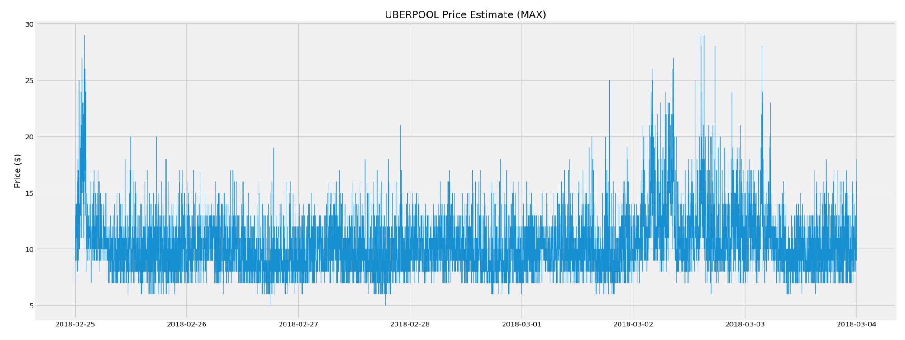
Feb 25th is Sunday and March 2nd has Rain and Snow
This proves Day and Weather affects price much

Slide 24
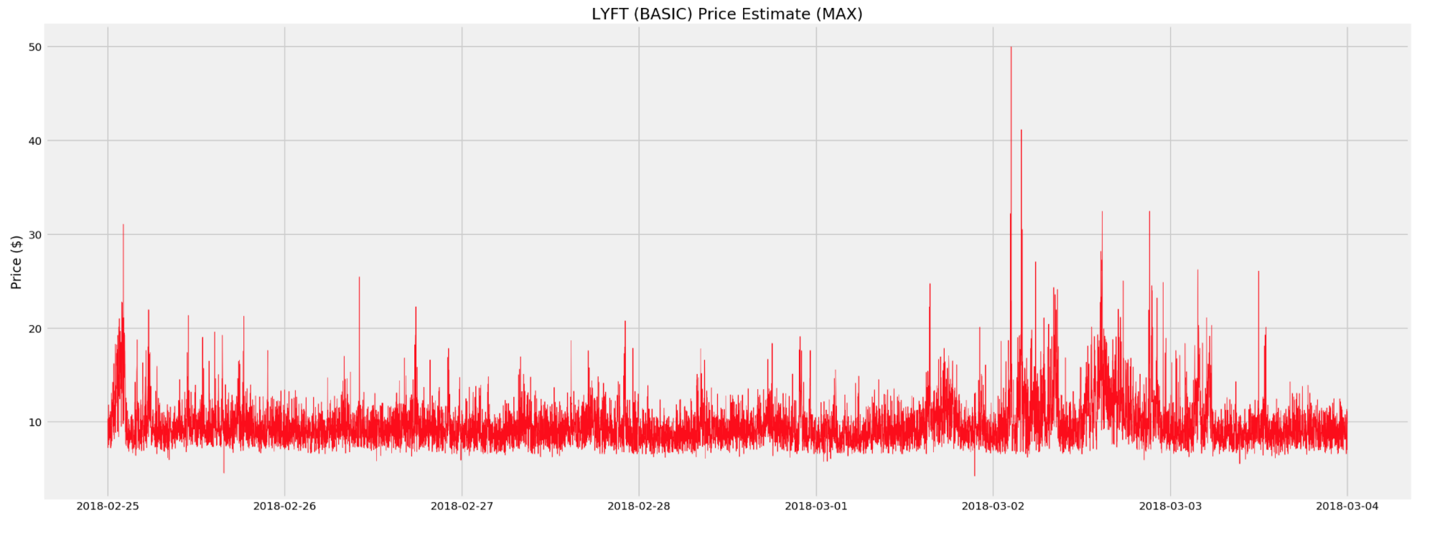
Since Y-axis of Lyft is much larger than Uber
It is cheaper to use Uber for customers when weather is terrible
On the contrast, it is better for driver to choose Lyft

Slide 25
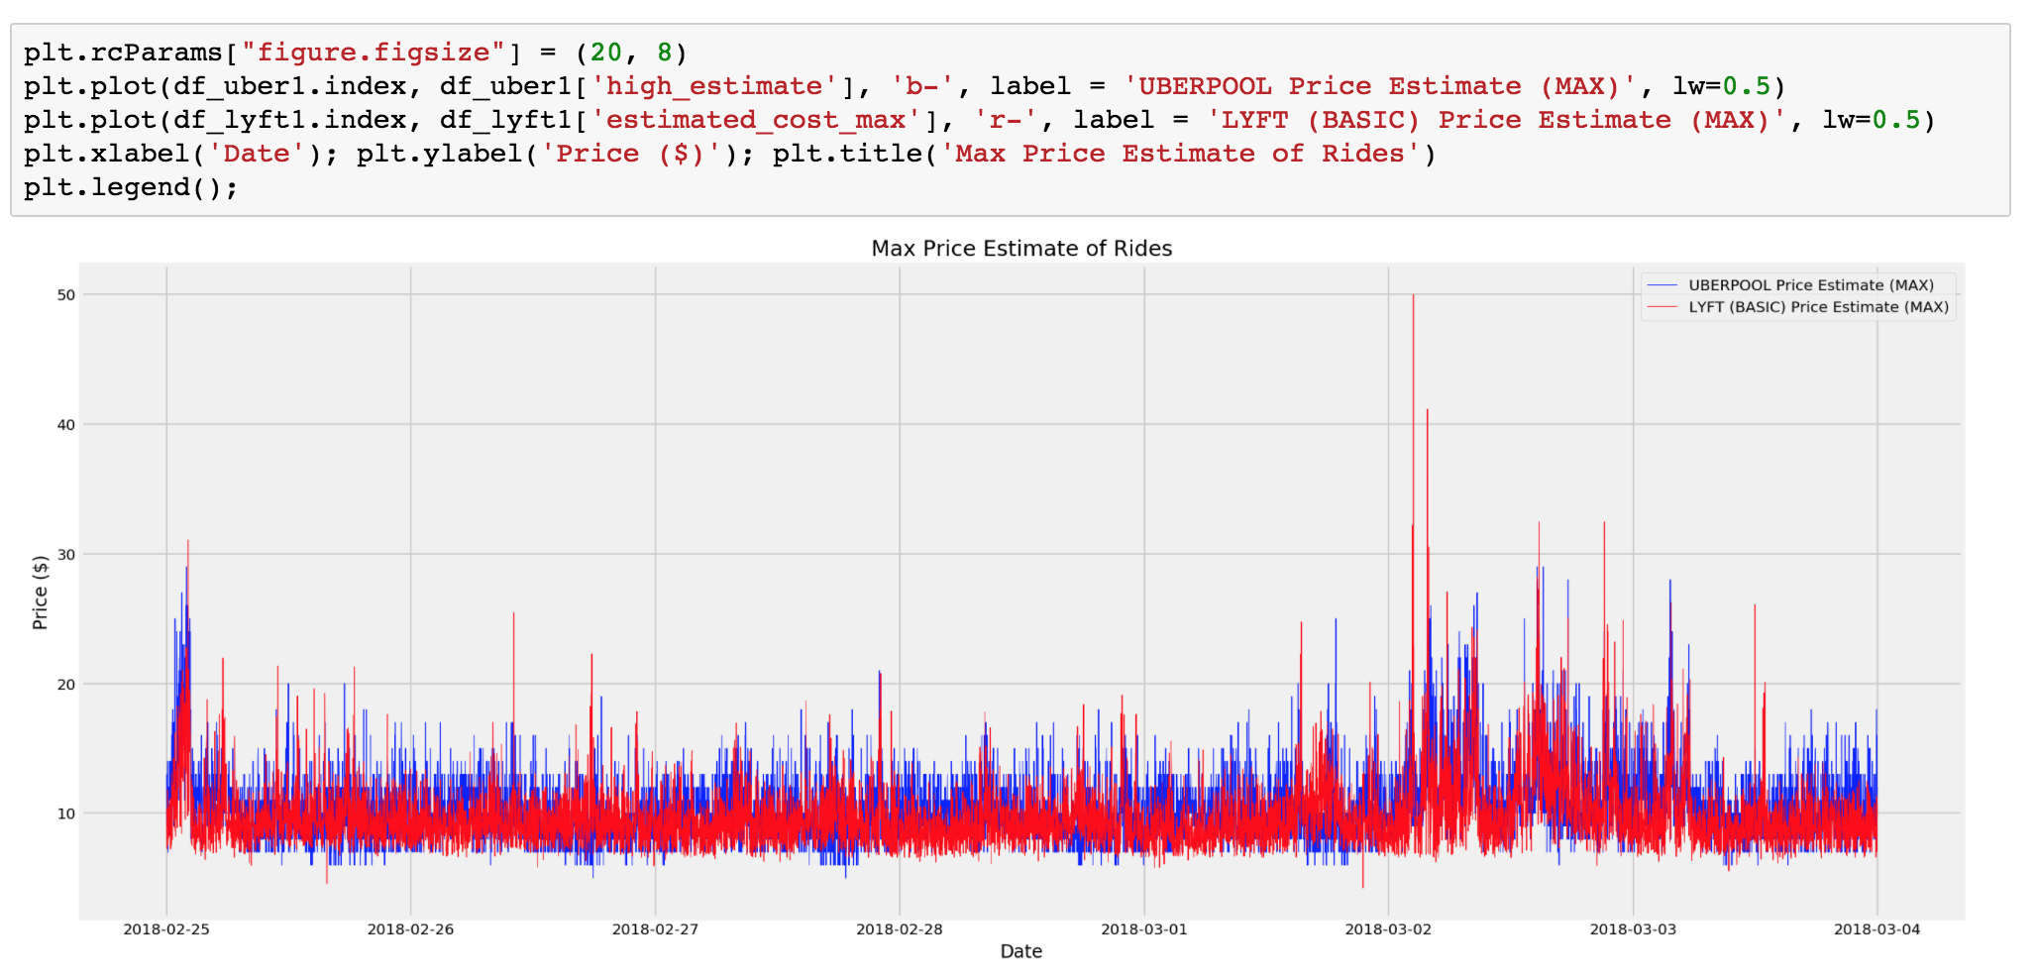
Normally, Lyft is cheaper than Uber
but when it faces high demand, its price is much higher than Uber

Slide 26
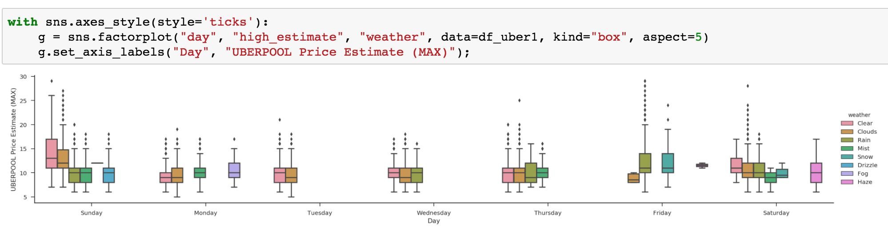
When there’s a bad weather, outliers becomes more
Price range become larger

Slide 27
What we do next
Merging Uber and Lyft data frame
Data visualization
More analysis
Get conclusion

Slide 28
Discussion

Slide 29
References
[1] Uber Api
https://developer.uber.com/dashboard/
[2] Lyft Api
https://www.lyft.com/developers
[3] Weather Api
https://openweathermap.org/api
[4] Time series - Wikipedia
https://en.wikipedia.org/wiki/Time_series
]

